Slide 1
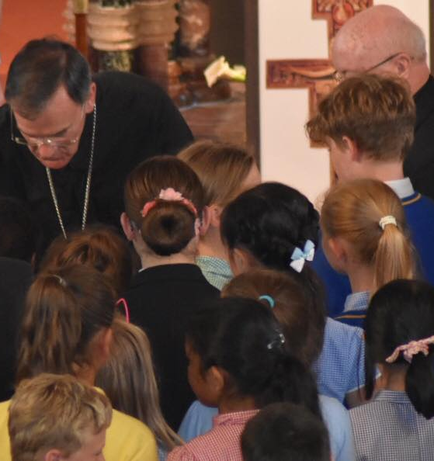

Introduction to
Hope in the Future

Slide 2


Notes:
Overview Video of Hope in the Future: Home, School, Parish (8 minutes 34 seconds) - https://www.youtube.com/watch?v=PEnKCICcVFw
This animated video gives an introduction to Hope in the Future, the 5 stages, Bishop John’s vision for Home School Parish partnership and practical ways young people can be Missionary Disciples

Slide 3
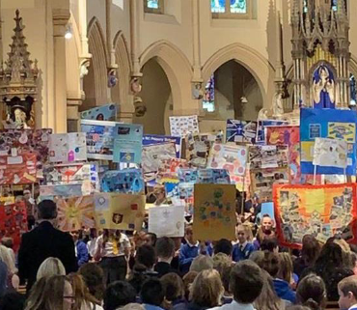
What is Hope in the Future?
Hope in the Future is an invitation to each of us, from Pope Francis and Bishop John, to be Missionary Disciples of Jesus by sharing our Faith in word and action.
On 4th October 2017 (the feast of St Francis of Assisi), Bishop John launched the programme in our Diocese of Salford. On 3rd October 2021, we launched Stage 4 of our journey focussing on ‘Proclaiming the Good News’.
Bishop John is asking our Homes, Schools and Parishes to work closely together as we grow in Faith together and share our Faith with those around us by what we say and do.
Notes:
More information is available here - https://www.dioceseofsalford.org.uk/faith/hope/

Slide 4
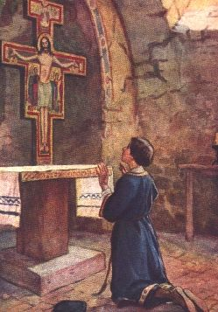
Rebuild My Church!
In the year 1205, at the age of 23 Giovanni “Francesco” Bernardino (who would later become St Francis of Assisi) was keeling before a cross in a small tumbled-down church is San Damiano.
Whilst praying, he heard the words of Jesus from the cross say ‘Francis, rebuild my Church’. At first he thought Jesus meant the building, but after reflection realised He wanted him to build up the Faith of His people.
This is why each parish and school has a blessed San Damiano Cross. Jesus gives us the same commission to us to Rebuild His Church! Will you respond?
Notes:
A reflection on the San Damiano Cross is available here - https://www.dioceseofsalford.org.uk/wp-content/uploads/6-Reflection-San-Damiano-Cross-reflection.pdf

Slide 5

The Journey so far…
Over the past three years, we have celebrated all the good happening in our parishes, schools and families.
We have celebrated our God-given gifts and talents.
We have tried to make our celebrations of Mass the best they can be.
Next, we will learn what it means to be Missionary Disciples of Jesus by Proclaiming His Good News to those around us.
In the final stage, we will share our hope with those around us by our care for others and our environment.
Notes:
More information on the 5 stages can be viewed here - https://www.dioceseofsalford.org.uk/faith/hope/the-five-stages/

Slide 6

More about Stage 4
We will learn about ‘The Great Story of Jesus’ and what is means for each one of us personally.
We will explore how we can share the joy Faith brings to our lives with our family and friends.
We will develop our Homes, Schools and Parishes so they can be places of prayer, learning, sharing and service.
Notes:
Stage 4 suggestions are available here - https://www.dioceseofsalford.org.uk/wp-content/uploads/Development-Suggestions.pdf
More resources will follow

Slide 7

The Great Story of Jesus
Here is a summary of our Faith in graphic form to help you take it to heart and share it with others.
Heart
God created me and loves me
Division
Sin has separated me from God
Cross
Jesus has reconciled us with God by his death and resurrection
Question mark
What am I going to do about it? Am I willing to be in relationship with him?
Notes:
Another version is available here - https://www.dioceseofsalford.org.uk/wp-content/uploads/The-Great-Story-of-Jesus.pdf

Slide 8

Hope in the Future Prayer
God our loving Father,
we thank you for blessing our parish and school communities
with all that we need to respond to our vocation
to be missionary disciples.
We ask you to pour out afresh the gifts of your Spirit
upon each one of us,
that we may be inspired to serve you in new and creative ways, bringing your light to the world.
We ask your blessing upon us as we journey together in hope through Christ Our Lord,
Amen.
St Francis of Assisi…Pray for us
Notes:
Prayer cards can be downloaded here - https://www.dioceseofsalford.org.uk/wp-content/uploads/Hope-in-the-Future-Prayer-Card-schools-v2.pdf
This could be a prayer to put up in your classroom and make part of your daily prayer

Slide 9
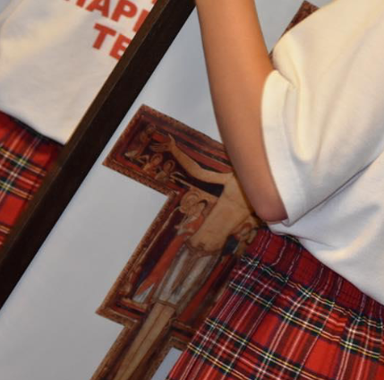
For more information and resources visit:
www.dioceseofsalford.org.uk/faith/hope/home-school-parish/
Notes:
For more information and resources visit:
www.dioceseofsalford.org.uk/faith/hope/home-school-parish/

